Slide 1
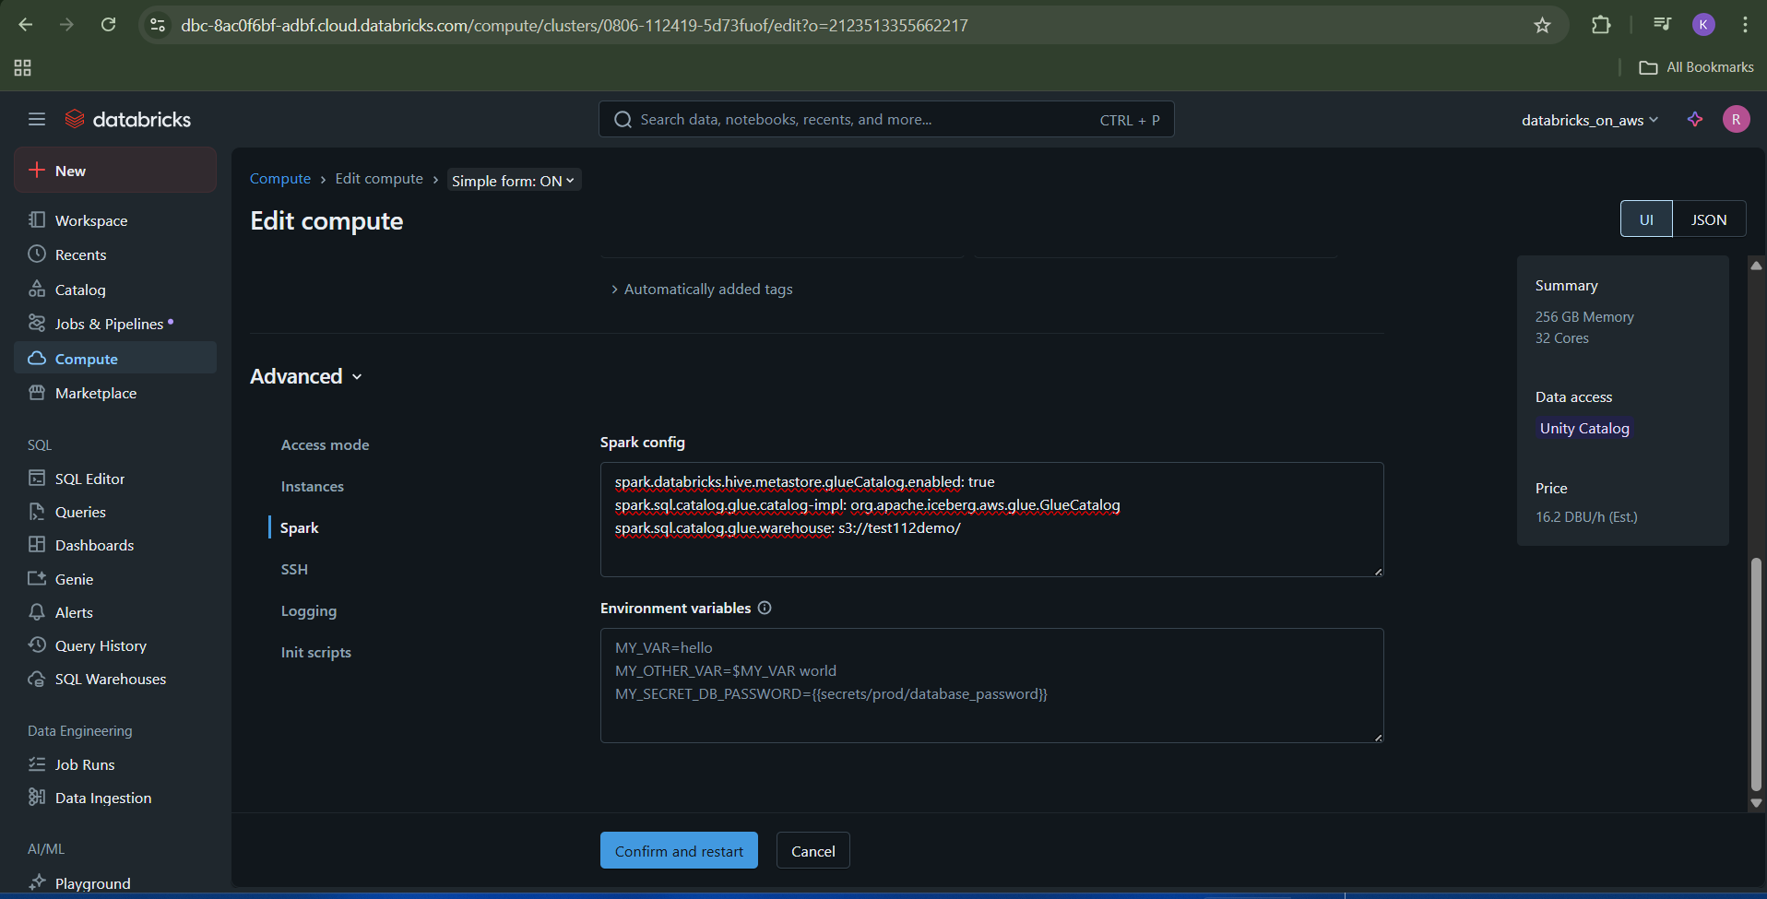

Slide 2
spark.databricks.hive.metastore.glueCatalog.enabled: true
spark.sql.catalog.glue.catalog-impl: org.apache.iceberg.aws.glue.GlueCatalog
spark.sql.catalog.glue.warehouse: s3://test112demo/

